Slide 1
Code a Christmas Tree
Coffee and Coding 11/12/18
Megan Stodel

Slide 2
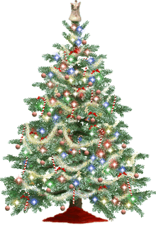
Session overview
Quick explanation
~ 45 minutes of tackling the challenge
Share progress / results
Notes:
Aim – to provide users with an overview of how to build a basic shiny app in R, using the template repository.
Give my coding professional/coding background as context of how quickly/easily this language this can be picked up.
Caveat; encourage questions/interaction
4 minutes

Slide 3

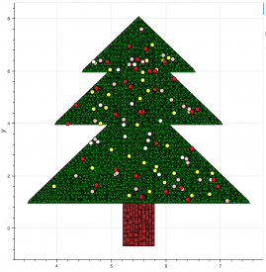
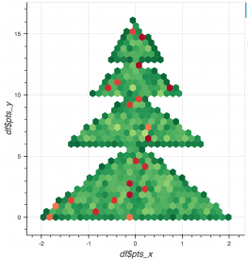
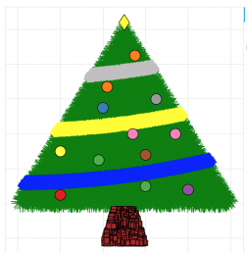
Examples
The top example uses geom_tile(), geom_point() and geom_segment(). Code here.
The other examples are the results of a session a bit like this one. Info and other examples here.

Slide 4
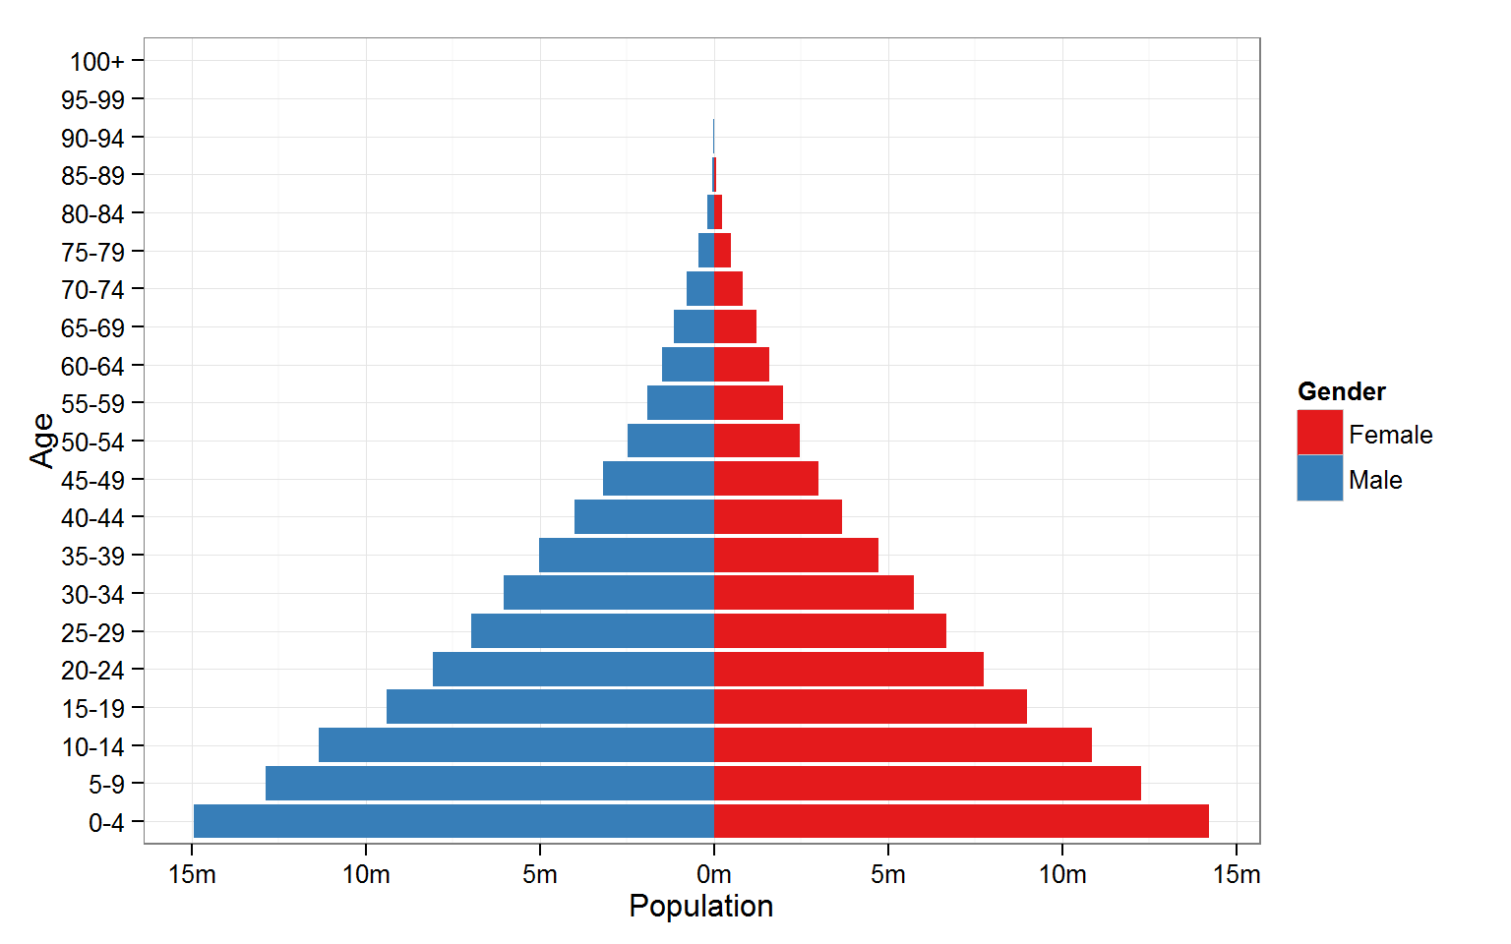
Option 1: Create a Christmas tree from scratch
Some approaches you could consider…
Population pyramid
Scatterplot
Histogram
Dumbbell chart
Violin plot

Slide 5

Option 2: Make improvements to an example tree
Add baubles! Add a Christmas tree stand! Add presents!
Or simply make it look more like a Christmas tree…
The code is available in the github repository: https://github.com/moj-analytical-services/Coffee-and-Coding

Slide 6
Get
coding!

Slide 7
When you’re done…
In the folder Coffee-and-Coding/Christmas trees_11-12-2018…
  Save your code in a script in the format yourname_tree.R (or similar)
  Export and save an image of your tree with your name in the filename.
Make sure you are on the branch christmas_tree_session.
Commit and push your script.
If you are having trouble doing this in the session but want to share your tree, email an image to me for now!
megan.stodel@digital.justice.gov.uk
If you aren’t ready in the session, you can still add your script and tree to the repo at a later date (or email me).

